Slide 1
Group Name
Haroon, Esher, Bill
RAL Visitor Centre
07.07.23

Slide 2


Vlad Ersteniuk

Slide 3
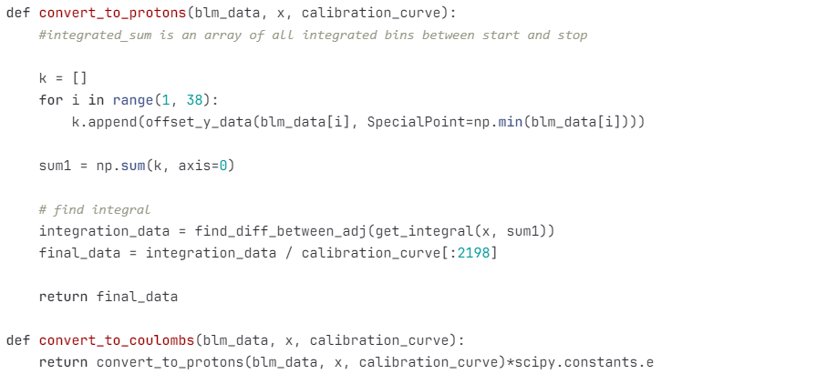
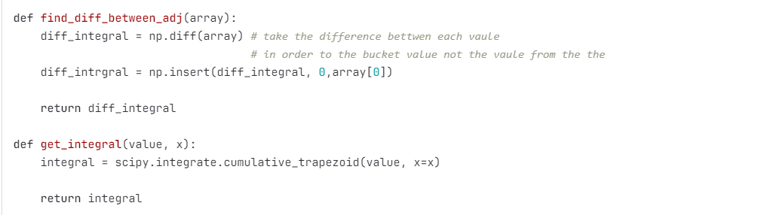
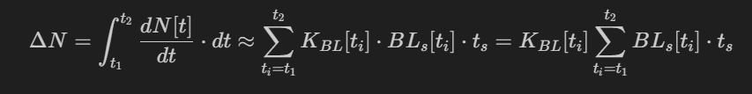
Stage 1 Energy Conversion: Integration and units conversion

Slide 4
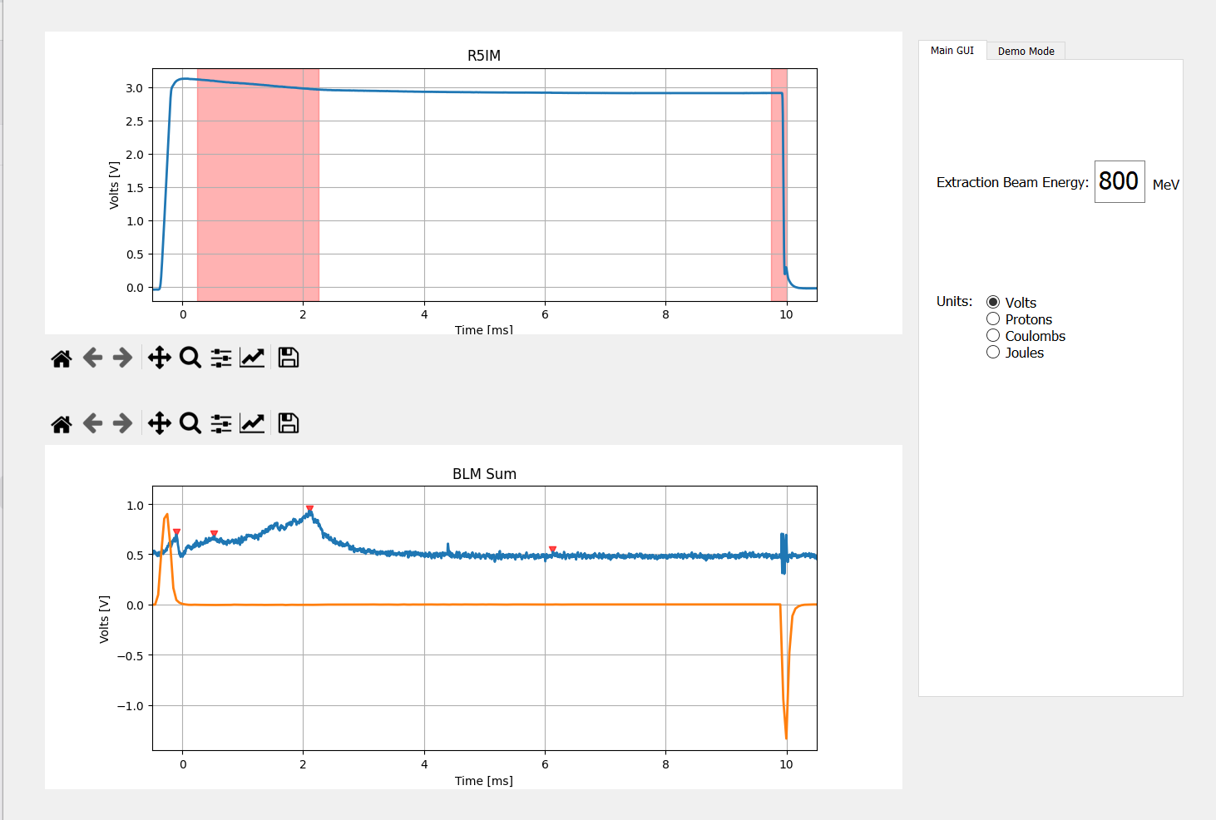
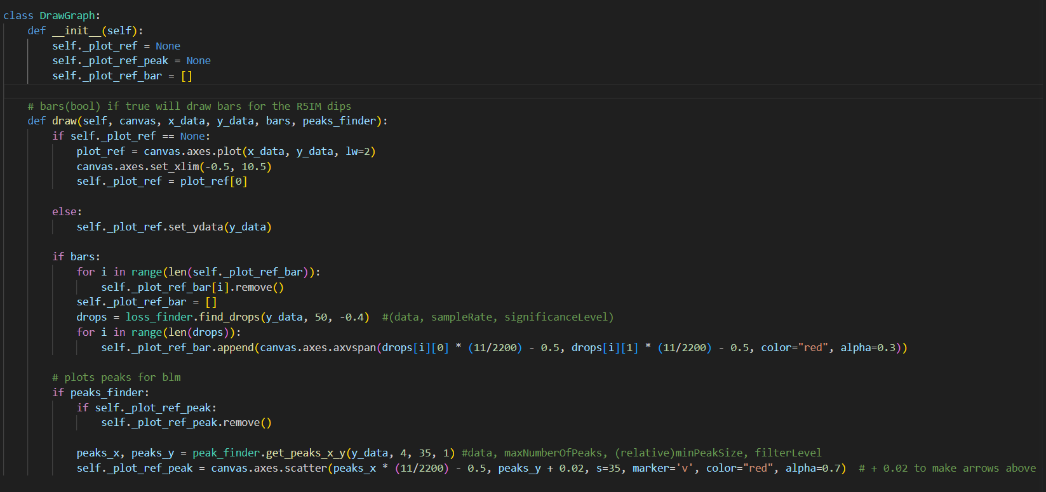
Stage 2: R5IM Loss & BLM Peak Finder

Slide 5
Each human should take a copy of this template, and fill in the above 3 slides
Each human should rename this template to their first name and save it
One human from each GUI group collect these templates and put them together (open 2 powerpoint instances and copy/paste the slides from the left menu), edit the title slide, acknowledgements, etc

Slide 6
Acknowledgments
We want to thank:
Public Engagement Team
Haroon
Esher
Bill
And other people who came to inspire with personal stories

Slide 7
GUI Demo
5 minutes max, show live data, demo mode, change some settings and show features

Slide 8
Thank you
Questions?

